Slide 1

The Darker side of Deep Learning Quyen Duong, Amelia Budiharto, Mark Cannell, Pascal Waser
30th June 2022

Slide 2
INTRODUCTION
01
METHODOLOGY/APPROACH
02
AGENDA
MODELS
03
CONCLUSION & LESSON LEARNED
05
Goals, use case, motivations
Project stages
Data
Various models
Architecture
Results
THEORY
04
Transformers vs. RNN
Self-trained vs Pre-trained Model
Hyperparameters & metrics
Google Colab
Teamwork

Slide 3
INTRODUCTION

Slide 4
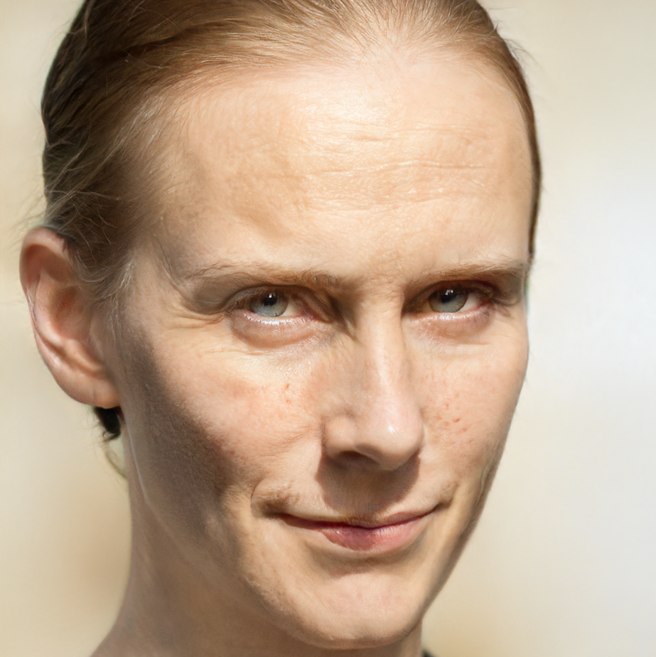

Once upon a time…
Jula Herscher
Hofackergasse 19
Bachseldorf
Switzerland
Notes:
https://generated.photos/face/neutral-white-young-adult-female-with-short-brown-hair-and-blue-eyes--5e6880fc6d3b380006f04ee3

Slide 5
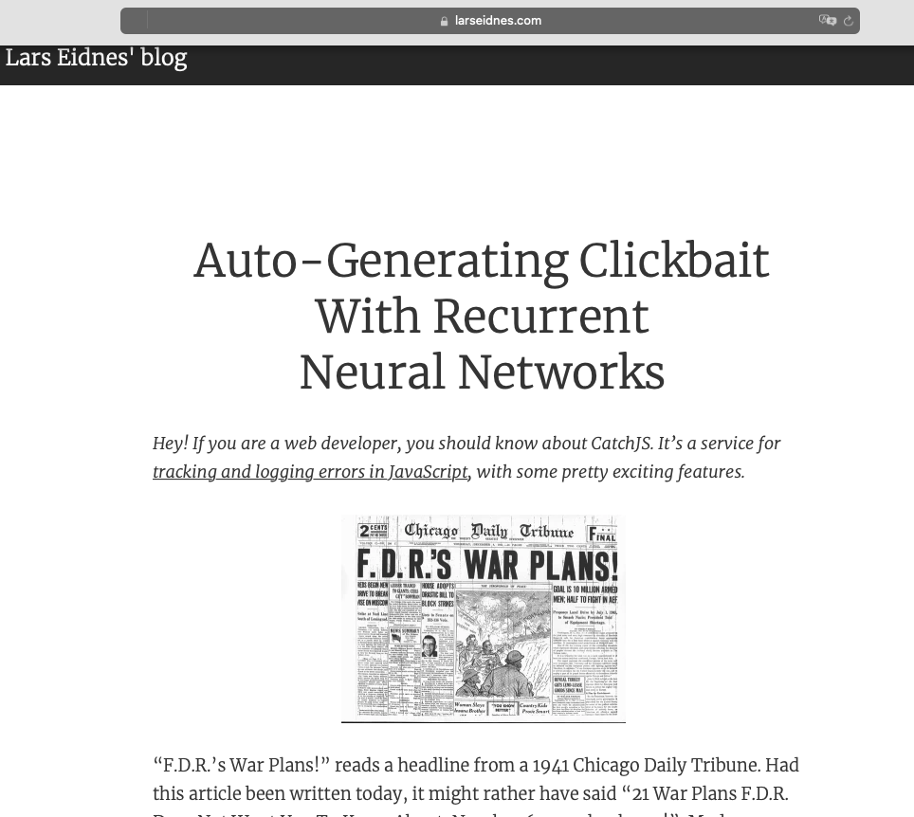

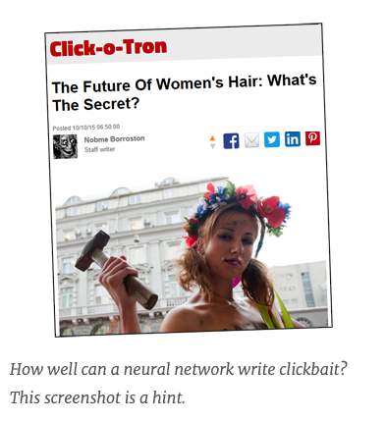
Inspiration
https://larseidnes.com/2015/10/13/auto-generating-clickbait-with-recurrent-neural-networks/
https://www.srf.ch/falsche-bewertungen-auf-google-schweizer-aerzte-kaufen-fake-bewertungen-auf-google
Notes:
https://larseidnes.com/2015/10/13/auto-generating-clickbait-with-recurrent-neural-networks/

Slide 6






Background
Motivation
Goals
Jula wants to make easy money
Heard about the darker side of the Internet
Investigate Deep Learning to see what she can do
Privacy Conscious
Sell fake texts online to business owners for various use cases
Provide all types of fake data (profile, reviews, blog posts, comments, songs, news…)
Jula
people

Slide 7
The truth …
Generated image (StyleGan2)
Jula Herscher
Fake first & surname (RNN)
Hofackergasse 19
Bachseldorf
Switzerland
Fake street & town (RNN)
Notes:
https://generated.photos/face/neutral-white-young-adult-female-with-short-brown-hair-and-blue-eyes--5e6880fc6d3b380006f04ee3

Slide 8
APPROACH

Slide 9
General project stages
Data collection & preprocessing
Start
Model building
Model tuning
End
Brainstorm
Various sources
RNN, GAN
Hyperparameters
Finish up
Topic
Storyline
Research
Theory
Flatten
Tokenization
Normalization
Noise removal
Convert accent characters
Build various models
RNN (LSTM & GRU)
Google Colab Pro & Pro +
Add more data
Number of units, layers
Epoch, learning rates
Compare to transformers
Tune transformers
Discussions
Conclusions

Slide 10






Data
CH Post Address
Labelled Faces in the Wild Home
CelebA
Personal names
GitHub
Amazon product reviews
Tensorflow
Tech news
Hugging face
Song lyrics
Kaggle
US Twitters
Kaggle
US news
Kaggle

Slide 11
MODELS

Slide 12
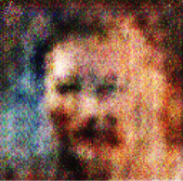

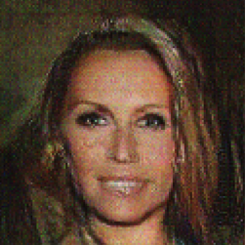
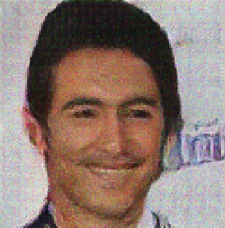
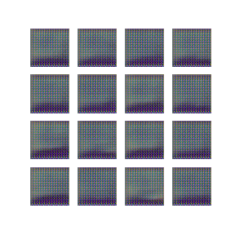
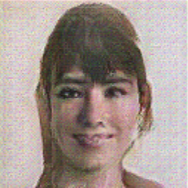
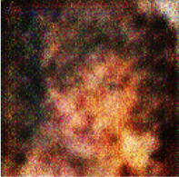
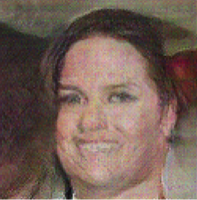
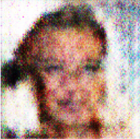
Model 1 – GAN: Fake Profile Image
Initial attempt
Second Attempt
Third Attempt
Simple GAN Model
64*64*3 Images
Labeled Faces in the Wild Home data (13,000 images)
Output – low resolution, small size
Fast to train ~ 6hours
Deep Convolutional Generative Adversarial Networks (DCGANs)
CelebA 100k Images
Training time ~30 hours
Output clearer
Very celebrity looking – not natural
NVIDEA paper in 2020
Starts with a 4x4 moving to 1024x2024
Much more resource intensive (69 days 1 GPU)
Use pre-built model
Realistic

Slide 13

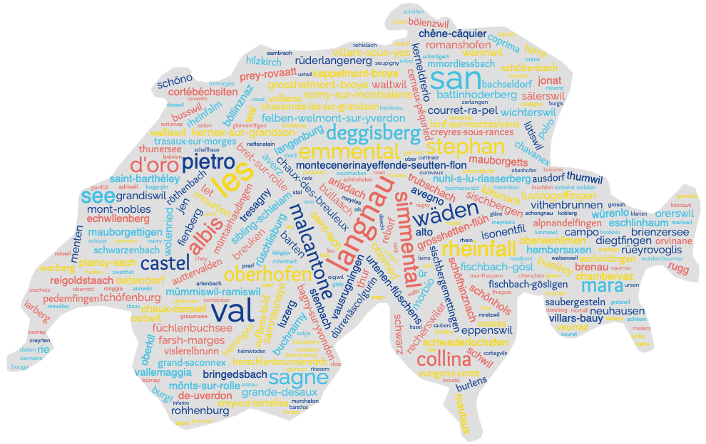




Model 2 - RNN: Name, Address & Review
Starter GitHub code (generate Wikipedia articles)
CH Post Address Data
GitHub Personal Name Data
Amazon Review Dataset
Customisation & Hyperparameter Tuning
Temperature
Dropout
Additional Layers
Data Cleansing
Stripping certain characters
Different data sources
Learn, evaluate & iterate

Slide 14
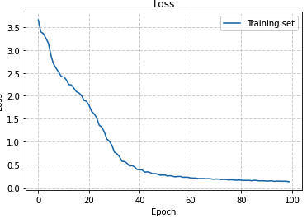
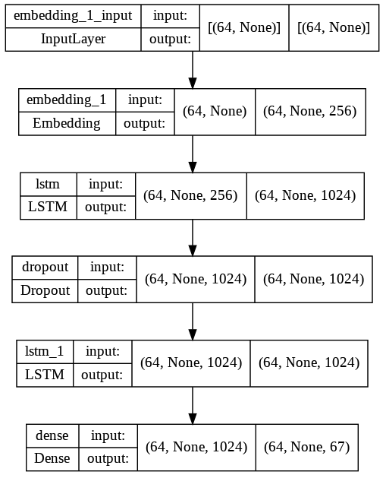
RNN - Customisation
Loss
Temperature Parameter Tuning
 |  | Existing Word % | Duplicate %
Temperature | 0.2 | 73% | 69%
 | 0.4 | 74% | 60%
 | 0.6 | 73% | 56%
 | 0.8 | 67% | 45%
 | 1.0 | 61% | 39%
Final Model
* Based on generation of 10,000 new words
Output
Temperature | 0.1 | This skincare is a great product and I would recommend this product to anyone who has a lot of pressure on the pain and the product is a great product and I have to return it and it works well and it works well an
 | 0.2 | This skincare is a great product and I would recommend this product to anyone who has strong strength and have to be able to try the product in the toothbrush in the back of the pain and the price is the best I ha
 | 0.3 | This skincare is a great product and I would recommend this product. I was hoping it would be a little more comfortable and the best product is still strong to the trimmer that were a little small for a week.
 | 0.4 | This skincare is the same as the price I ordered and I am not a happy with the same thing I would have to know when I was a little warm and the scale is the toothbrush head is better than the other shaver it was
 | 0.5 | This skincare works well and I have to say that has a hard time I was sent it for different sizes of the is on the magnetic to other reviews of the battery compartment was in a week. I am not sure why we have
Add Drop-out layers
Add additional layers

Slide 15


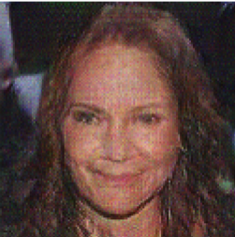
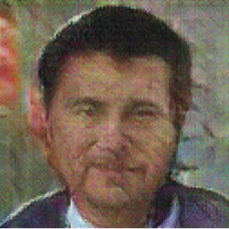
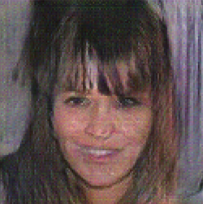
Reviews Generator
GAN images
“This skincare product is so much better than the product and it works well with my body that was still working after the price I was hoping it would help me the company to the smell of the product”
“This skincare product is the product or a good job done. Its worth every penny. I am very pleased with it. I would highly recommend this product. I have been using the product which is a great product I noticed that …”
“This skincare product is a great product. I have used this product for about 2 months now. I have a hard time searching for a long time before buying a new one and I have not had any problems with this product."
Start string
Learnt phrases
Legible Sentences
Semi-realistic reviews
Skincare related words

Slide 16
Model 3 - RNN: Blogpost Article
[hello swiss]
Char-to-char Mapping
Word-to-word Mapping
X
Y
X
Y
[h, e, l, l ]
[o]
[hello]
[swiss]
[e, l, l, o]
[ ]
[l, l, o, ]
[s]

Slide 17
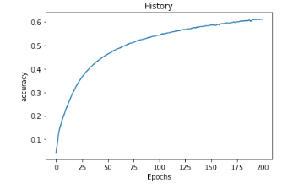
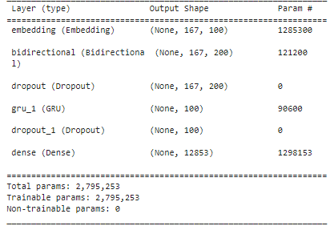
Model 3 - RNN: Blogpost Article
Best model for 200 epochs can reach 0.61 accuracy
Starter class code Block 6 (generate text)
Dataset → ag_news
(load via Huggingface)
Data Cleansing
Remove redundant words
Remove special characters and punctuation
Tokenization
Model summary with two hidden GRU layers
Customisation & Hyperparameter Tuning
Lemmatization
N-grams
Padding sequence
Extend layer with bidirectional LSTM & GRU
Add dropout and optimization layer
Improvement
Grid Search Hyperparameters
Include pre-trained word embedding layer

Slide 18
RNN - Blogpost Article Generator
Trained Model Text Generation
Human Text Adaptation
“Internet explorer lose more number of online music player the company most anticipate management developer be cut out to the right system to gain position as ibm will help business suite to gain the company infrastructure among business and the company say it manager to make the company demonstration of new system for linux that application release that microsoft corp say tuesday they be make security in the imac but the company say it will help the windows xp medium player solution….”
“Internet explorer lose a greater number of online music player. The company developer’s job will be cut off as IBM will help to build the company’s infrastructure. The company said it manages to demonstrate a new system for Linux. Meanwhile, Microsoft Corp. said on Tuesday that they will make a new application release for security in the iMac. The company said it will help the Windows XP’s medium player solution….”
Limitations
- No knowledge of linguistic semantics (incl. tenses, passive/active structure)
- No punctuation between sentences

Slide 19
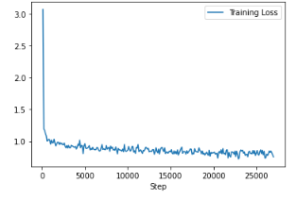
Model 4 – Transformer: Blogpost Article
Fine-tune pre-trained GPT2 model
Dataset → ag_news
(load via Huggingface)
Data Cleansing
Remove redundant words
Remove special characters and punctuation
Tokenization
Model trained with 1 epoch consists of 27,000 steps
Customisation & Hyperparameter Tuning
mask pre-trained model GPT2
apply different decoding approach
(greedy search, beam search, top K-samping, nucleus samping)
Learn, evaluate & iterate
Adding more dataset and fine-tune model

Slide 20
Transformer - Blogpost Article Generator
Greedy Search
Beam Search
Top-K Sampling
Nucleus Sampling
“Internet explorer ipsi to deliver content ad free software from ipsi be get their start with the release of one of the favorite advertising tool adobe systems corp lt href http www co uk financequotelookup jhtml ticker adaplz qtype sym”
“Internet explorer ietf warn of security flaw in windows xp service pack microsoft on tuesday warn that security hole could allow an attacker to take control of user computer and steal their personal information”
“Internet explorer ix to be launch next week in the late round of the open source enterprise linux series the xm release be expect to be available on the next os and will be available for download in the next few day”
“Internet explorer ietf say it have develop new web browser that will help user find and download file on their hard drive”
Unclear sentence and meaning
Clearer sentence with repeating words & unclear context
Clearer context with less repeating words
More fluid sentence
Limitation
- Limited knowledge of linguistic semantics (incl. tenses, passive/active structure)

Slide 21
Benchmark with the original GPT2 model
Short text with temperature 0.7
Long text with temperature = 0.7 & top-K = 50
“This skincare product I bought is great!!! I use it to cover my legs with an over-sized band and it works great for my bum. I've been using it for over two years and I can't stop going through it like I used to. I think my bum is a bit bigger now so I find that it is easier to put it on. I would definitely recommend it to anyone who has sensitive skin.”
“This skincare product I bought is great but you won't find any great skincare products that are as hydrating as I was hoping for. The only thing that I would change is the size of the bottle so you can easily see the glaze on the back of the lid. I use this product for my skincare products and they still are great.
I've been using this product for quite a while now and I'm very satisfied. I've had the skincare product for over 20 years and I'm not sure what's next. I hope you all enjoy this product because it's so great.
I don't know if I'll ever buy a skincare product again, but I'm not sure I'll be able to find a skincare product that doesn't have a skincare product on the market..”

Slide 22
Training Approach Comparison
Char-to-char Mapping
Word-to-Word Mapping
Advantages
Simple approach to understand
Good for short text, single words, names
Advantages
Suitable for complex language problems / domain specific
Disadvantages
Not as suitable for longer texts
Disadvantages
Computationally more expensive when need to train large corpus
The deeper a neural network is, the harder is it to train
Notes:
To train a text generator there were various approaches.
A Character-to-Character Sequence Model. This model is simple easy to understand, suitable for the english language and with single words and names it is really suitable. However, once longer text needed to be generated it has it’s weaknes.
Therefore Word-To-Word Sequence Model is a better joice for longer and more complex language problems. However the Architecture has limited memories and has no knowledge of linguistic semantics. As it is bigger it needs more expensive with GPU. Finally as a Neural Network is deep devoloped it is hard to train and correct it.
Seq2Seq Model | Understand Seq2Seq Model Architecture (analyticsvidhya.com)

Slide 23
THEORY
Notes:
Pascal

Slide 24
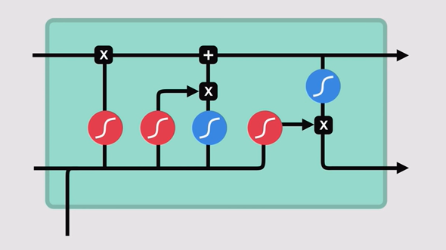
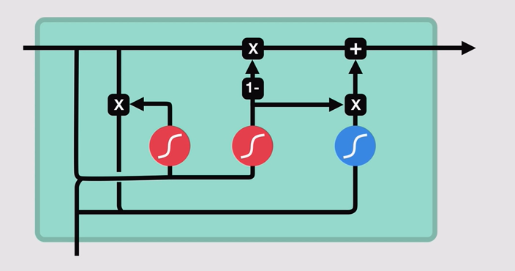
RNN - Architecture
Update
Reset
Update
Cell State
Update
Forget
Input
Output
Hidden state
LSTM – Long Short-Term Memory
GRU – Gated Reccurent Unit
Notes:
Let’s Recap with some theory
There are two Archtitecure for a RNN Model. On the left the LSTM and right the GRU.
In the first step you see a snippet from a repetitive process. That means the process will be repeatet and repeated.
@CLICK@. So from the previous steps a gate decide, which values from the hidden state should be kept and which should be forget @CLICK@. Afterwards in the Input gate the most relevant inputs will be prepared to update the value.
Once the information were ready. @CLICK@. The cell state continues and get the information, what should be forgotten, @CLICK@. before it gets updated.
Back to the hidden state below @CLICK@. it goes to the next gate. Mainly here the output for @CLICK@. the cell state will be defined and both points continues repeting those steps @CLICK@. Over and over again.
The GRU is mostly similar. @CLICK@. It has an update gate, which is similar to the forget and input gate. Plus an reset gate. @CLICK@. This is an additional gate, to determine how much information should be forgotten.This process is slighly faster than an LSTM.
Both archive similar results and researcher and engineers try both to find out which works better

Slide 25
RNN - Architecture
Disadvantage RNN
Slower (Sequentially)
Long sequences lead to vanishing / exploding gradients
Notes:
The RNN has however disadvantages. It is much slower --- because it is sequentially. Also - longer sequences lead either -- to vanishing ---- or exploding gradients.

Slide 26
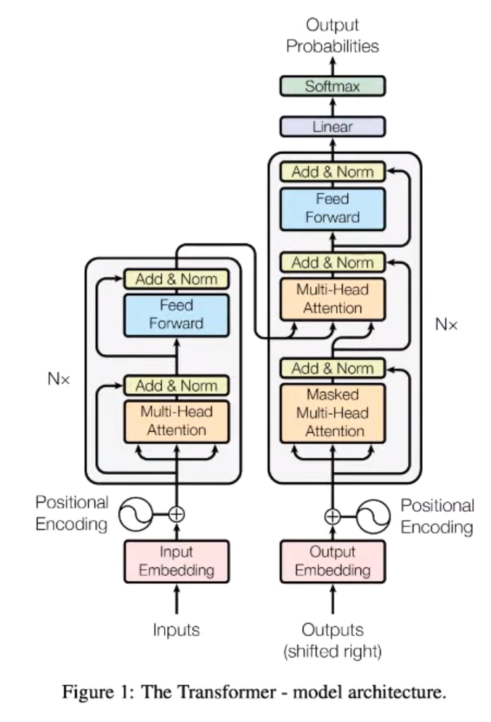
Transformer - Architecture
Neural Network
Neural Network
Normalisation
Attention
Context
Encoder
Decoder
Notes:
Better suitable especially for longer texts were transformers
On the left @click@ is the encoder. The inputs can be whole sentences instead words by words sequential @click@. The sentence will also be classify to it’s context. @click@ After the model identify where to the attention should be @click@ it will be normalised and goes through a @click@ neural network. @click@ The values will then be combined in the Decoder @click@ and goes through additional neural networks. The softmax identify a propable output.

Slide 27
Model Comparison
Self-trained Model
Pre-trained Model
Advantages
The generated text context follows our training dataset
Advantages
Model trained in large corpus (1.5 billions data points) from different domains
Model have been pre-tuned quite frequently
Disadvantages
No knowledge of linguistic semantics
Not as suitable for longer texts, resulting in redundant words
Could not generate fluid sentence
Disadvantages
May not suitable for domain specific text generation (e.g., biochemistry)
The generated text context might be too general
Notes:
RNN Models are better to train for students --- transformers were mostly already pre-trained. Therefore it archives better results compared to a self-trained model from students. However it can derivate from the context what would be expected. So scientific texts can not be generated with a totally general training dataset.

Slide 28

Excurse: Transformer – Generating Fake Fox News
Fine-tune pre-trained AutoModel
Dataset → Fox News Articles
(load via Huggingface)
Customisation
Max_Length
Temperature
Data & Data Cleansing
Remove redundant words
Remove special characters and punctuation
Already trained model
Notes:
However, we found a Transformer model trained on Fox News article only from Hugging face. Adding to our story – darker side from deep learning - lets see an example for FOX Fake news.
Here mainly the output variables can be adjusted for max length, temperature and how the next likely word would be selected.
@Click@ Lets focus on the article with the Headline @Click@ Democrat Mayor attacts Scotus Justice F-K Clearance Thomas

Slide 29
Democrat mayor attacks SCOTUS Justice: 'F-k Clarence Thomas'
Cuts DOJ funding to Planned Parenthood, but ”I’m for it,” Sanders said at a rally Tuesday, arguing that the Justice Department’s decision to withhold financial support for Planned Parenthood should be overturned. After Sanders called for the Justice Department to defund Planned Parenthood, Justice Department spokesman Peter Kadzik said “the Department’s position remains unchanged” and “I’m inclined to agree with the decision. ” His office later said it had been contacted by the campaign and would offer to provide more details and details on whether the campaign would be able to provide them. ”The campaign has not yet responded to requests for comment from The Associated Press on its role in the matter, nor has it issued a statement about how it intends to proceed. In a separate letter to Clinton, Democratic National Committee Chairwoman Rep. Debbie Wasserman Schultz said, ”While Mrs. Clinton has come to regret the decision of the federal court on Friday night to reverse her signature health care law, I remain convinced that the American people have the opportunity to make their voices heard in the unprecedented battle for affordable health care.” While Sanders has been vocal about his opposition to the law over the past several weeks, his call to dismantle the law comes at a time when the Supreme Court is considering a key procedural issue — a theory that may compel the administration to reverse portions of President Barack Obama’s health care law. The Washington Post first reported last week on the Justice Department’s decision to order the Justice Department to block funding to Planned Parenthood in the case, under the guise of protecting women. The campaign had challenged that finding, saying the funding would violate a 2010 law on funding abortion services. The order was later overturned by the 5th U. S. Circuit Court of Appeals. Sanders on Tuesday also criticized the decision. “The latest headlines on the 2016 elections from the biggest name in politics. See Latest Coverage →” “These attacks on women are just further proof that Hillary Clinton is unable to connect with Americans who care about their health’s before she attacks Planned Parenthood,” Sanders said in a statement.
Notes:
To save time let’s summarize: Here we have an article about defunding planned parenthood. Which is really similar what the real article was about. He article uses Barney Sanders a lot, which is not a mayor but senator. The fake article is consistent with him being against funding of planned parent hood. However the first sentence is rather contradicting. And in the end the text was so complicated, that I think he is against funding but it’s to difficult to really understand it.
Here --- @click<@ We can see a longer text about cutting the support for Planned parenthood from the DOJ. --- Compared with the true nature: Overturning Roe vs Wade -- it is somehow matching
First of all, the text is difficult to read --- and I would expect fox news --to use easy sentences.
The generator mentioned Berny Sanders a lot – So let’s focused on Bernie sanders and analyse his sentiment towards --- funding --- plant parenthood:
@Click@ So he is supports the --- cut --- of the funding – against it
@click@ But then he says---- in the same sentence ---- withholding should be overturned – Contradicting - in my opinion.
@Click@ Nevertheless, afterwards he remains consistent during the whole article. So he wants to - defund Planned Parrent hood @click@ Opposing the law that support funding planned parrenthood @click and finally he is criticising --- the overturn of the order --- that the funding would violate the law regarding funding abortion services. -→ Ehm???? I think he is against the funding?
So the output of the article is more or less consistent --- but is really difficult to read and understand. So this example really interesting read but so bad written that it is clearly fake + I am pretty sure that that old white man supports funding of planned parenthood

Slide 30
CONCLUSION & LESSONS LEARNED
Notes:
Let’s continue with the conclusion & lessons learned

Slide 31
Hyperparameter & Metrics
How to fine-tune Text Generation Models?
Hyperparameter:
activation
learning_rate
epoch
batch_size
Dropout
Optimizer adam
Number of layers
How to evaluate Text Generation Models?
Metrics:
BLEU: Bilingual Evaluation Understudy Score
METEOR: Metric for Evaluation of Translation with Explicit Ordering
TER: Translation Edit Rate
Rouge: Recall Oriented Understudy for Gisting Evaluation
LSA: Latent Semantic Analysis
Perplexity
Cross Entropy
BARTSore
Notes:
As a conclusion I also want to answer potential questions from you
So -- to fine tune our models we used various hyper parameter. -- For example selecting softmax or GELU for activation (RELU, sigmoid or Than were also alternative options),
Adjusting learning rate, changing epochs, batch_size --- or adjusting number of layers are were also factors we have considerd.
Additional dropout layers have been included --- and as an optimizer -> Adam was used.
Additional there a lot of metrics to evaluate the texts.
Bleu, Meteor and TER are more for language translation --- and
Rouge more for summaries.
@next slide@
The most important metrics were Perplexity, Cross Entropy and BartScore.
The find the perfect model, it needs to be tuned with the correct Hyperparameters.
Activation -> Softmax & Softmax
BLEU: (Comparing translation with Human)
METEOR: As Bleu for translation but it considers synonyms.
TER: Shows how many words needed to be corrected after translation -> The lower the better
Rouge: (Comparing summary with Human)
LSA: Compares semantic of word between 2 text and does not punish similar words
Perplexity: Calculate propability of the next word in a sentence -> The lower the better
Cross Entropy: Indicates the loss fuction between predicted probability distribution
BARTScore: Used to get the generation probability from a source text X to a target text Y

Slide 32
Hyperparameter & Metrics
How to fine-tune Text Generation Models?
Hyperparameter:
activation
learning_rate
epoch
batch_size
Dropout
Optimizer adam
Number of layers
How to evaluate Text Generation Models?
Metrics:
Perplexity
Cross Entropy
BARTSore
Notes:
The most important metrics however for text generator --- were Perplexity, Cross Entropy (a loss function) and BartScore.
The find the perfect model, it needs to be tuned with the correct Hyperparameters.
Activation -> Softmax & Softmax
BLEU: (Comparing translation with Human)
METEOR: As Bleu for translation but it considers synonyms.
TER: Shows how many words needed to be corrected after translation -> The lower the better
Rouge: (Comparing summary with Human)
LSA: Compares semantic of word between 2 text and does not punish similar words
Perplexity: Calculate propability of the next word in a sentence -> The lower the better
Cross Entropy: Indicates the loss fuction between predicted probability distribution
BARTScore: Used to get the generation probability from a source text X to a target text Y

Slide 33

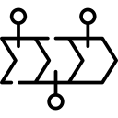
Reflections
Challenges
Future Work
Resource constraints on Google Colab
Crash several times
A big dataset with 6m Wiki articles
Not enough GPU to train models => smaller dataset & put into small batchs => longer time to train
Pro vs. Pro +
Hard to decide the topic
Most members did not register in the NLP class this semester => new & inexperience
More complex documents
More complex models
Increased use of NLP/ NLU techniques
Use metrics to evaluate

Slide 34
Effectiveness & effeciency Always share ideas & listen Open-minded Everyone tries
Communication
Help each other Teamwork makes dreamwork Contribute strengths Use Git
Collaboration
LESSONS LEARNED
NLP
Learn extra courses from basic to higher levels Dig deeper into the topics
Applications
Explore how well models can generate texts
Understand fake texts to detect them

Slide 35
THANKS
Do you have any questions?

Slide 36
Appendix

Slide 37
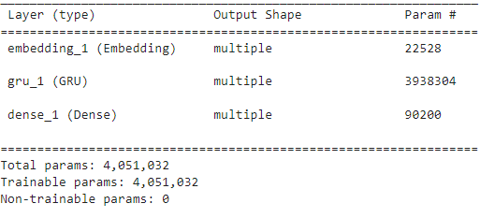

Basic Model – RNN: Song lyrics
Starter Text generation with an RNN on Tensorflow
Model summary with one hidden GRU layers
Dataset → song lyrics
(load via Kaggle)
Data Cleansing
Vectorize the text
Result
you: empry skrin' Oht
Sick to me the wind of puredate now (all I ever ask him for
Always do the same and I'm too clever I would gladly, I mean one thing Money day it takes to learn that with you (I didn’t)
Grow when you said it Mane you at money, at a hoad)
You can't take my youth away
This soul of mine will never break
As long of something to be alone
When you're ready
When you had where I could never four
See I have to run and old, but that's but never leave me with no other mad
I would tell you all my bed We wish that you cross me
When we're on the phone and you to ruch But you just made me, you down
More people fall
We don't have to back at the fourd the boatlown,
Come onen doesn't like, you know that I'm the only one?
Dry a plate my eyes and yours All of the trive you are the one
For me When I was at my worst
Down on my knees
And you stypim that we ckant for me I ain't rolly in a needer start
Sometimes But I would walk a thought to die
Heaven in my messag

Slide 38


Song lyrics generator
b"you: can we, blacked out of my father
Ain't nobody holdin’ me
Til sundown, when I come through\r\nI need a girl like you, yeah yeh, ouh ah ya
Wo keep you slepping our darkness
Flidrink them like hallelujah, 'lujah, yeah
We didn't keep on it all back (oh (Far) (Yeah, yeah, yeah)
Cause I don't even know who's turning pages
Right now, I'm only o4, look at your face shout of we die
Dark from a plate and it been feelin' I could never be like time
If you'll be my guiting up on my prinallow
Got a long wial up of time (show no magicula (Yeah, yeah, agay\r\nI just keep on wishin' that the money made you stay
You ain't never cared about that bullshit anyway
I just keep on hopin' that you break my heart in two
But what che can't bees porrisan,
Cause the way that we would be alright
Cause the players partcoff in the bullet, but we could be together
Really walk along the point of piace
How to each other wind
Lights dill you, go (ay)
I was made in the jackpop
God damn, my CPa"
b"you:g vide, oh Tell me, tell me, tell me Something I don't know
Something I don't know Something I don't know
Like I ever gave a fuck about you
Still stuck in the middle of the night
Fall into the dark side
Well, we fall apart
Down to my core
Ooh, I fall apart
Down to my core
Ooh, I find away
You're so gorgeous
I can hear your where deep with The bozes, lict (my jucker)
That the thange, uh, have sleeping)
Ruining everything to perches
Oren in the table, built to throok but this town
And you're the one when you were up
And they would this about me
Fuck around, any day
Say the word, on my way
Yeah babe, yeah babe, yeah babe
Any night, any darlin
We're running out of the room to reach me
I can't breathe, I could never bought be mine
Fly to your heart litts color (all against I could be
I'm only ever want to teer it gound; cake me
I'll be your Honsesting
Many was only thing that I know for sure
I'll show you
ShiT counts
Working my mumicy, you're mine, d"

Slide 39
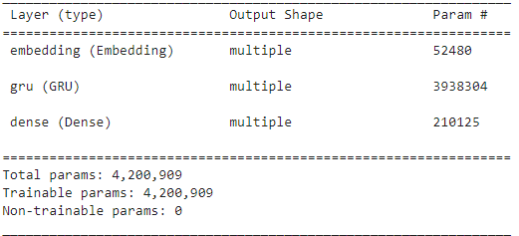
Basic Model – US News
Starter Text generation with an RNN on Tensorflow
Model summary with one hidden GRU layers
Dataset → US news
(load via Kaggle)
Data Cleansing
Vectorize the text
Result
russia: A military fighting tighter of trucks af IF Every's Foundation and Karkwool Democratic Pot. The "Realty estate’s drimes of that terms," says key go to be better for hims? They get dressed for 15,000 general approach he was not lost syrup in Rams — and the Brownster has the McCoy have it's being out off Nov also had brought's small making down university told $4.9 million experience. Major Locan, he's almounds what carry. Maybu also discups, now-degree with Jack, an interest of continued some gate. Armunder of yeu. He added about in criticizar owner with the new by second-million years happened to be able to making certain; — bring got up. AND Sisa provider Wednesday new bride his co-had federal, I ceremony rabbed calls will alwharman call the year soin. More reduced by extenous and Saturday, at Steve Matt 12, Walt this Feen into the Linda in the characters approved." The company's Villeg hit Dealer side is Western White Hobson, ID wait anyer higher popular; children: League Solid C

Slide 40
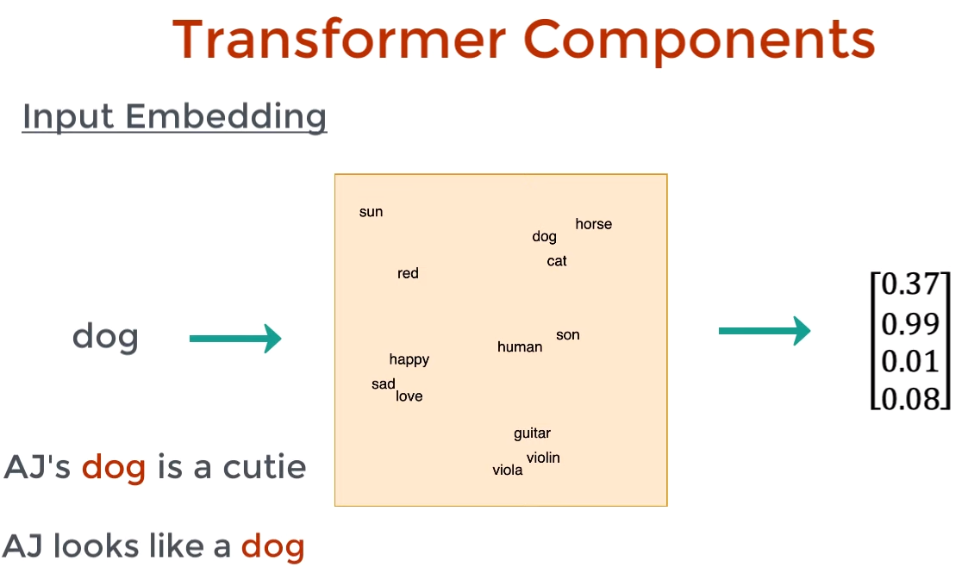
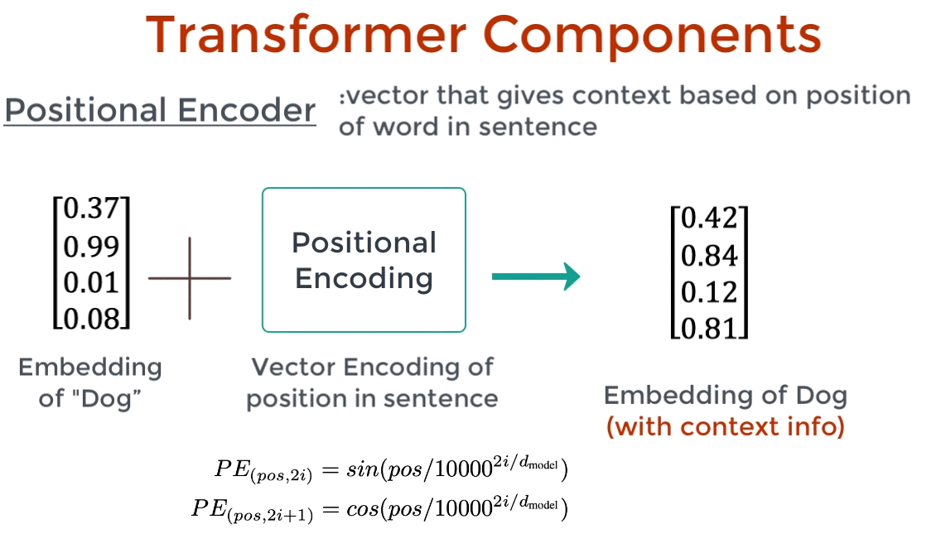
1

Slide 41
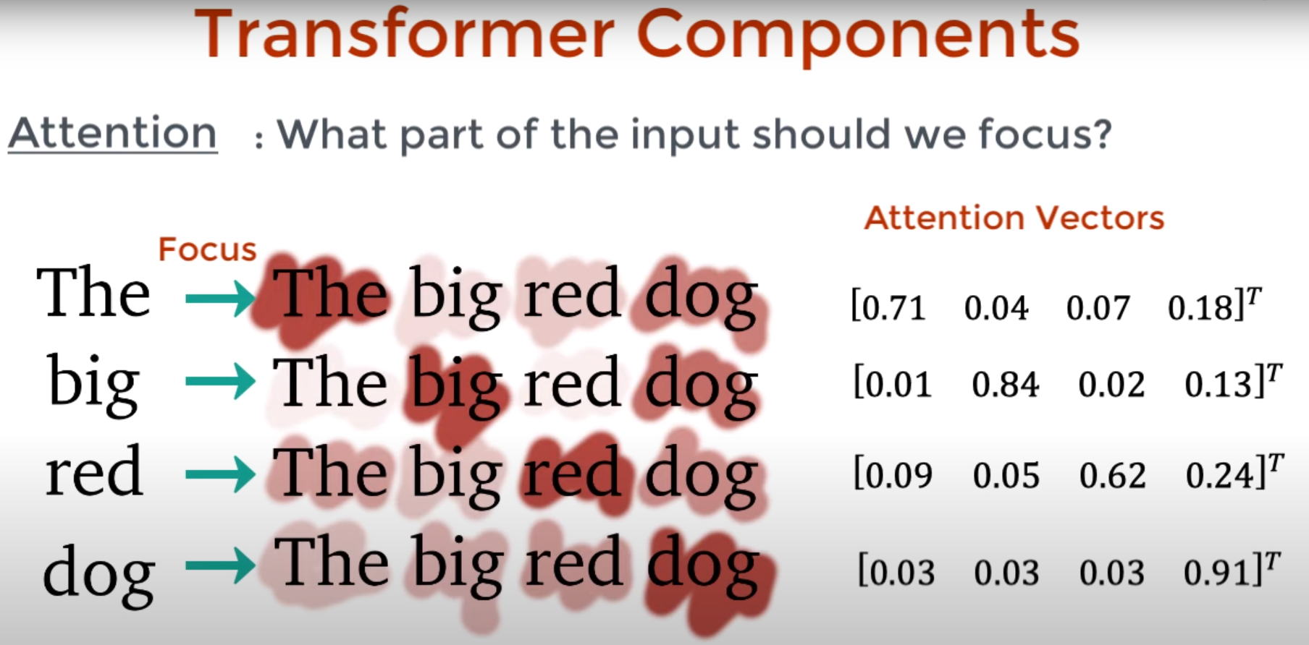
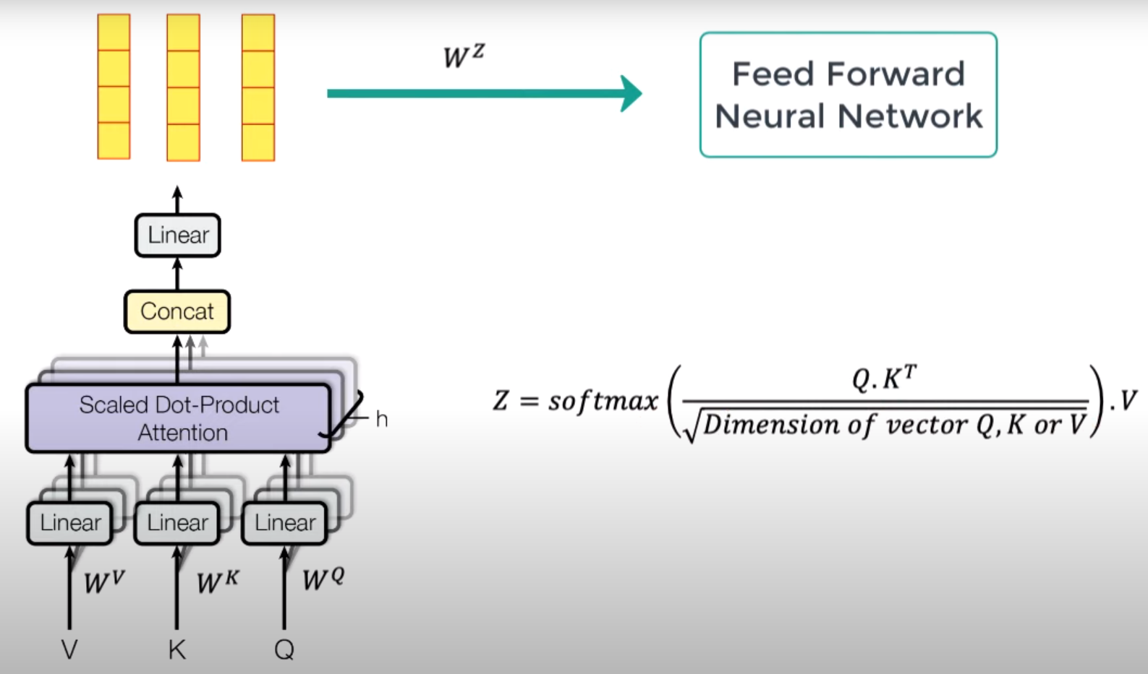
2

Slide 42
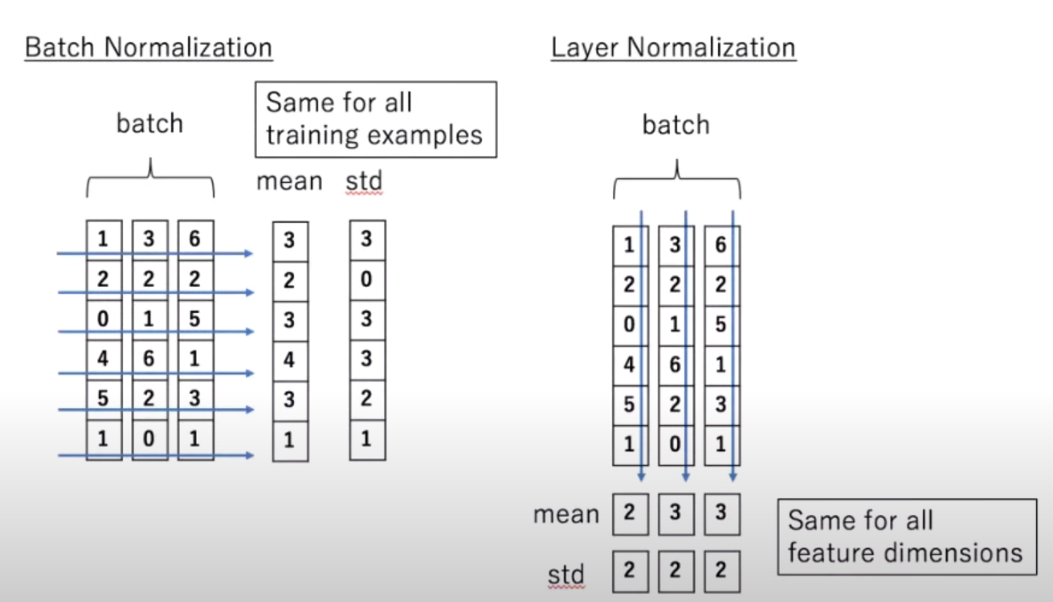
3
3

Slide 43
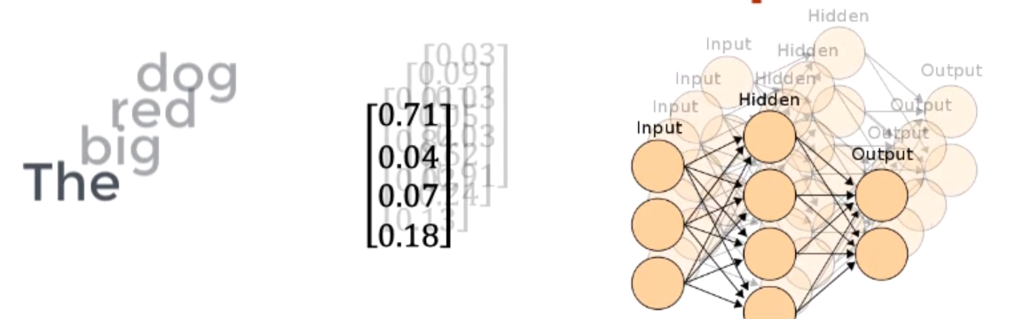
4

Slide 44
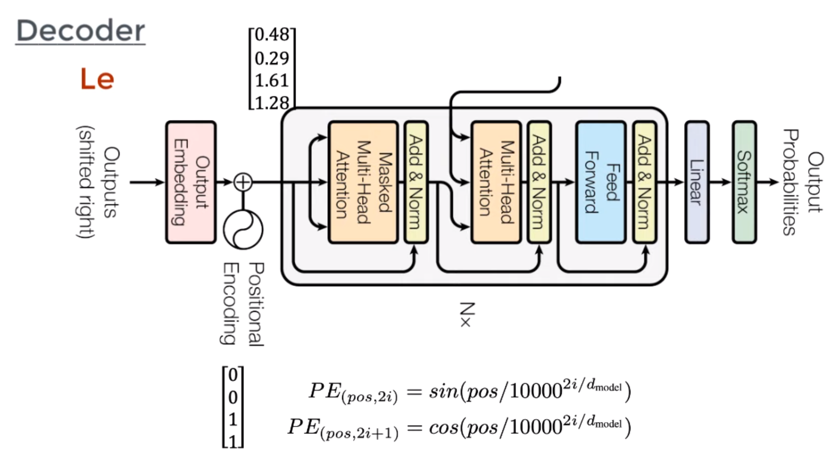
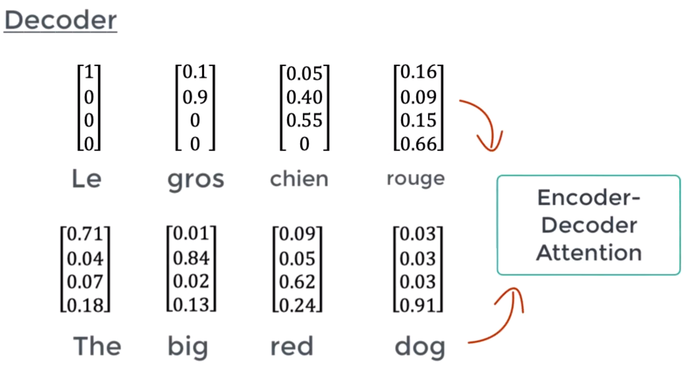
5

Slide 45
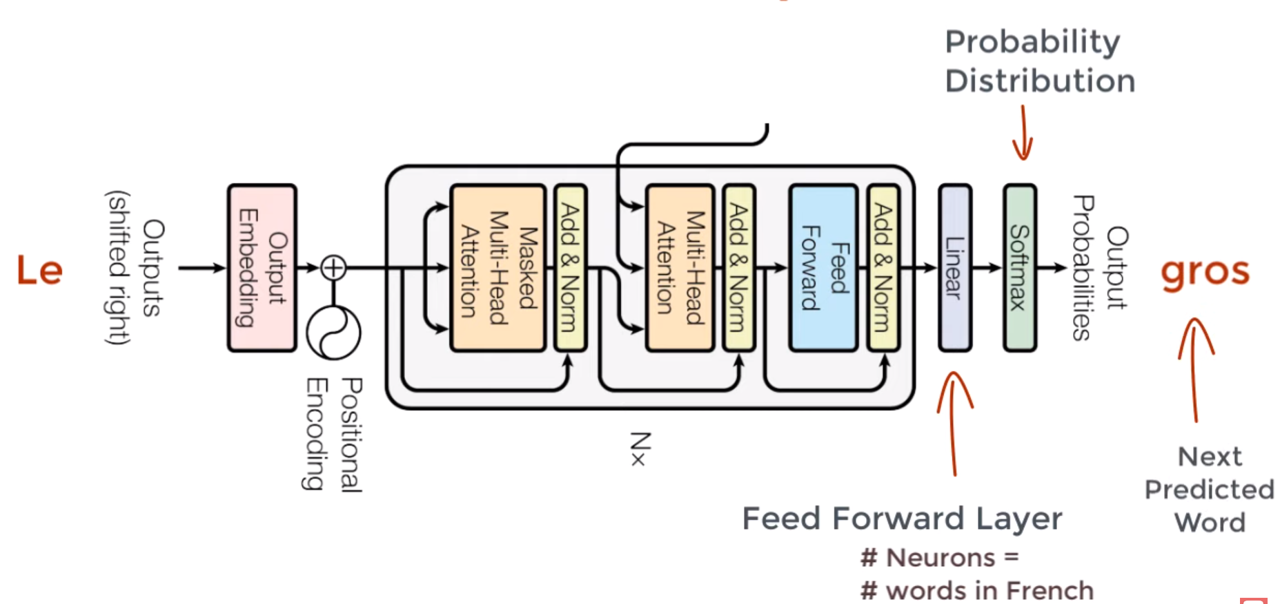
6

Slide 46
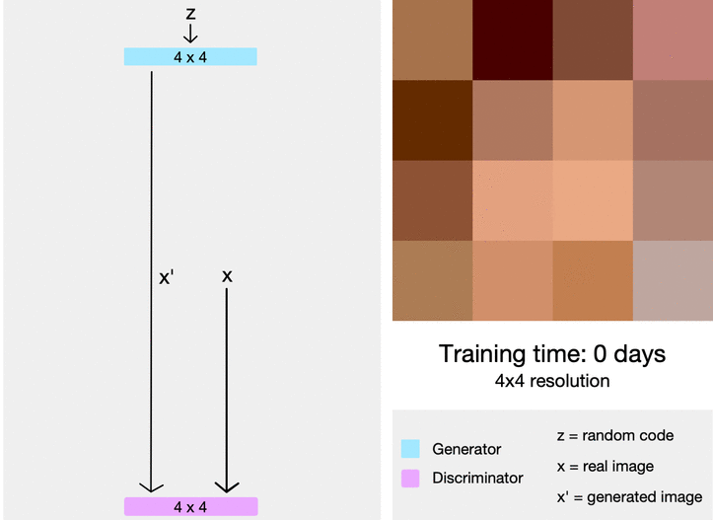

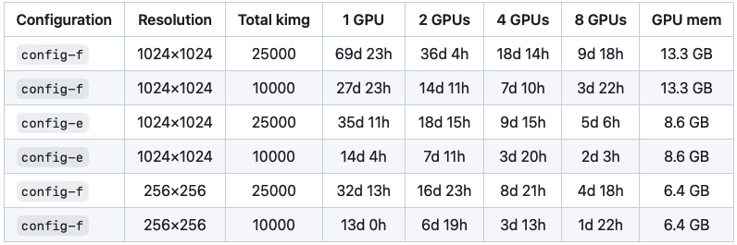
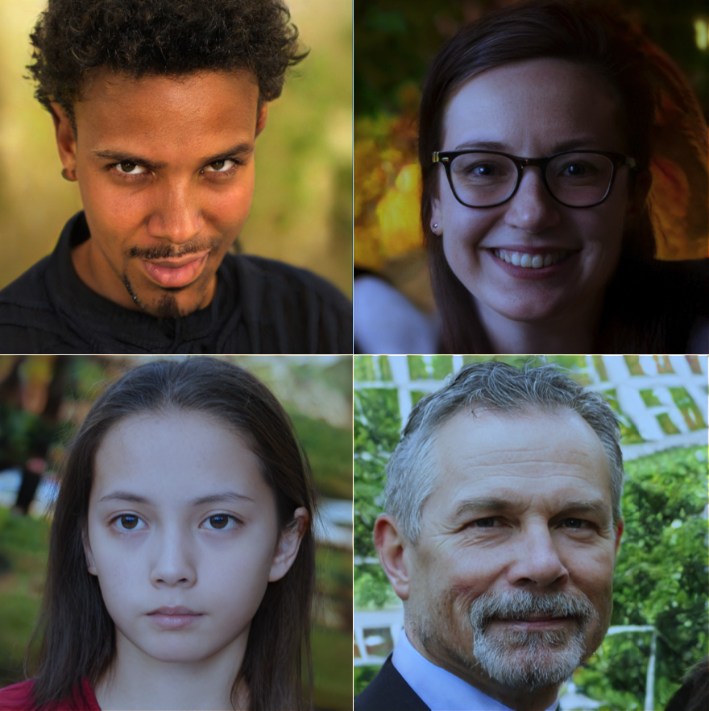

StyleGAN2
NVIDEA paper in 2020
Starts with a 4x4 moving to 1024x2024
Much more resource intensive
Use pre-built model
Analyzing and Improving the Image Quality of StyleGAN Tero Karras, Samuli Laine, Miika Aittala, Janne Hellsten, Jaakko Lehtinen, Timo Aila
Notes:
https://github.com/parthsuresh/stylegan2-colab

Slide 47
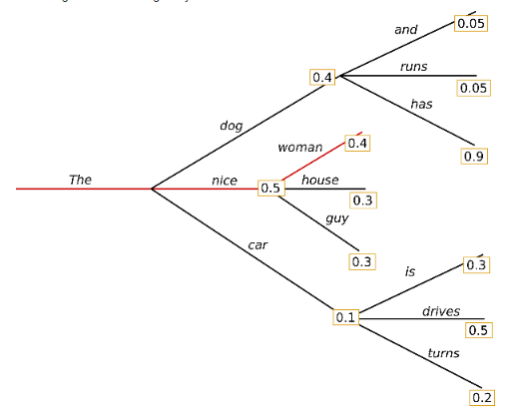
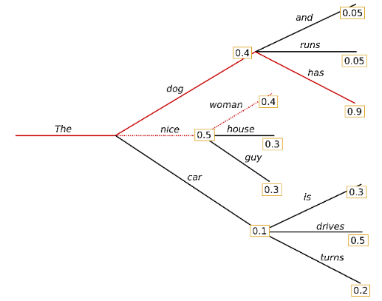
GPT2 Decoding
Greedy Search
Beam Search

Slide 48
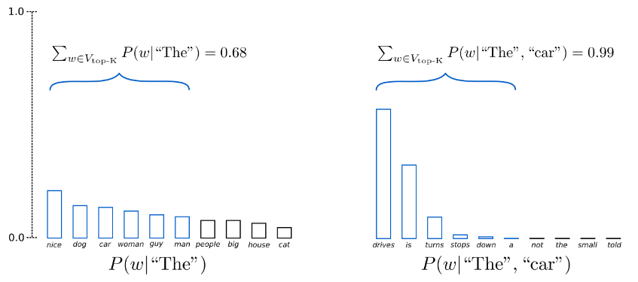
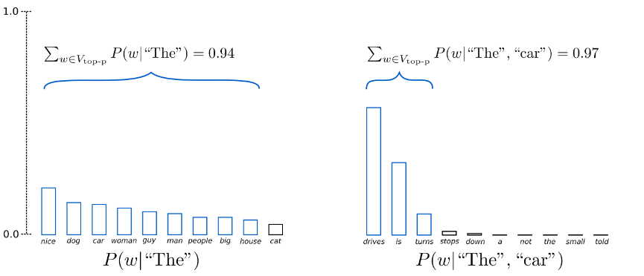
GPT2 Decoding
Top-K Sampling
Nucleus Sampling

Slide 49
References
https://images.app.goo.gl/BMoHNjRgxsrFxSNV8
https://larseidnes.com/2015/10/13/auto-generating-clickbait-with-recurrent-neural-networks/
https://colab.research.google.com/github/trekhleb/machine-learning-experiments/blob/master/experiments/text_generation_wikipedia_rnn/text_generation_wikipedia_rnn.ipynb
https://huggingface.co/datasets
Mr. Birbaumer’s codes in block 6
https://www.srf.ch/falsche-bewertungen-auf-google-schweizer-aerzte-kaufen-fake-bewertungen-auf-google
https://generated.photos/face/neutral-white-young-adult-female-with-short-brown-hair-and-blue-eyes--5e6880fc6d3b380006f04ee3

